Slide 1
Lab update – Risk Model
Fall 2024

Slide 2
Introduction
Goals: To model risk within a building based on community level disease prevalence
The model: Multilevel – metapopulation model using ODEs
Networks are based on floorplans of buildings
Notes:
This project is about estimating the risk of infection to building occupants. While most risk models look at community level risk we are interested in investigating individual level risk. People spend most of their time indoors in various different buildings and so we also want to compare risk levels across buildings with different topologies or layouts.
We use a multilevel-metapopulation model of ODEs. One component is the community level model to evaluate what the community level prevalence of a disease is and this will serve as the initial conditions for the building level model.
The model uses networks represented as adjacency matrices that are based on floor plans, and we will talk about these first.

Slide 3
Creating the network based on floor plans
Let A be a square matrix with i rows and j columns.
Each entry of the matrix represents the presence or absence of an edge between node i and node j.
The presence of an edge is indicated by a 1 and the absence of an edge is indicated by a 0
A node is any compartment in a building that people may occupy. Each node can be described as a room, hallway, stairway or elevator.
An edge represents a connection between two nodes via a doorway.
We define rooms as a spaces that have at most 2 doorways or a node where it would be expected that individuals will spend greater than 5 minutes in the space.
We define hallways to be any space that has more than 2 doorways or individuals are expected to spend less than 5 minutes occupying that space.
Elevators and stairways are nodes that connect to other nodes that are on different levels of a building.
We assume that elevators can connect to hallways on any level of a building however stairways can only connect to the floor immediately above or below the current floor.
We make this assumption because we presume that the rate at which individuals travel between the farthest apart floors (e.g. bottom and top floors) of a building via a stairway is different than the rate at which individuals travel between the floors immediately above or below their current floor. However, people may use elevators to get to any other floor in the building at equal rates.
Now with our rooms, hallways, stairways, and elevators identified, we then break up the hallways into multiple hallways for similar reasons to that of the definition of stairways. We assume that the rate at which individuals use the full length of the hallway to be different if their destination is closer to the beginning of the hallway.
Therefore, we first break up hallways into additional hallways at any corner or possible change in direction, and then further break up any hallway at the midpoint if the length of the hallway is greater than half of the length of the building based on the floor plan scale.

Slide 4
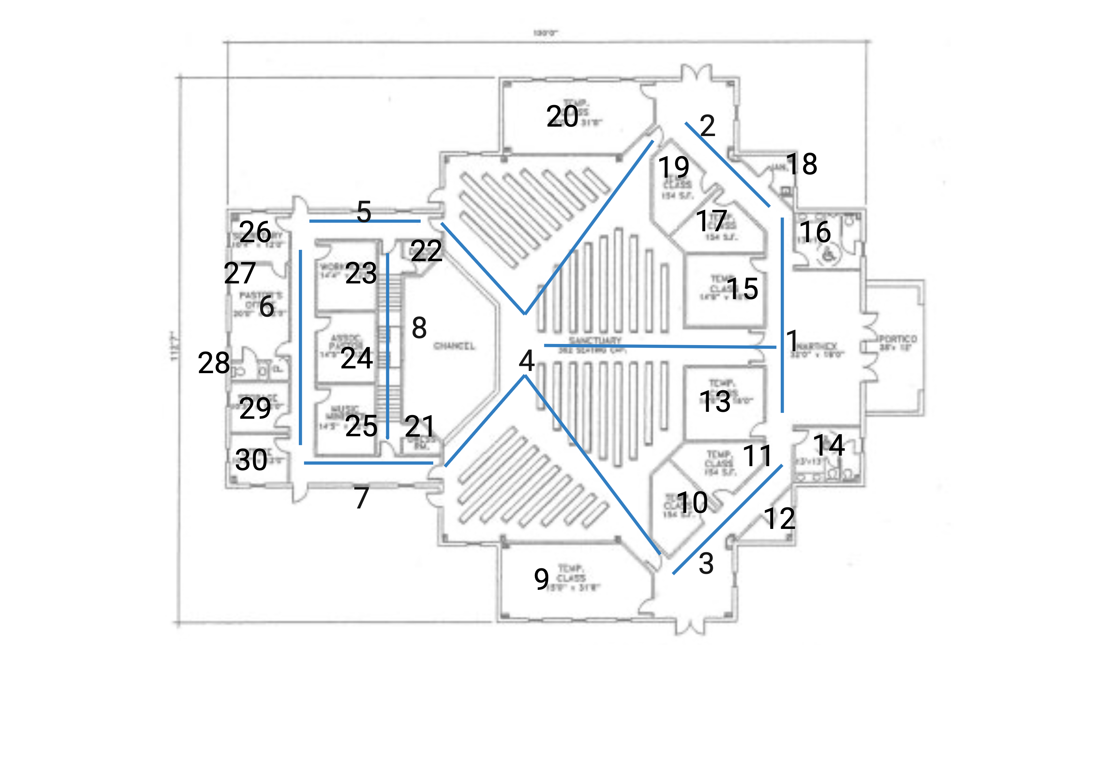
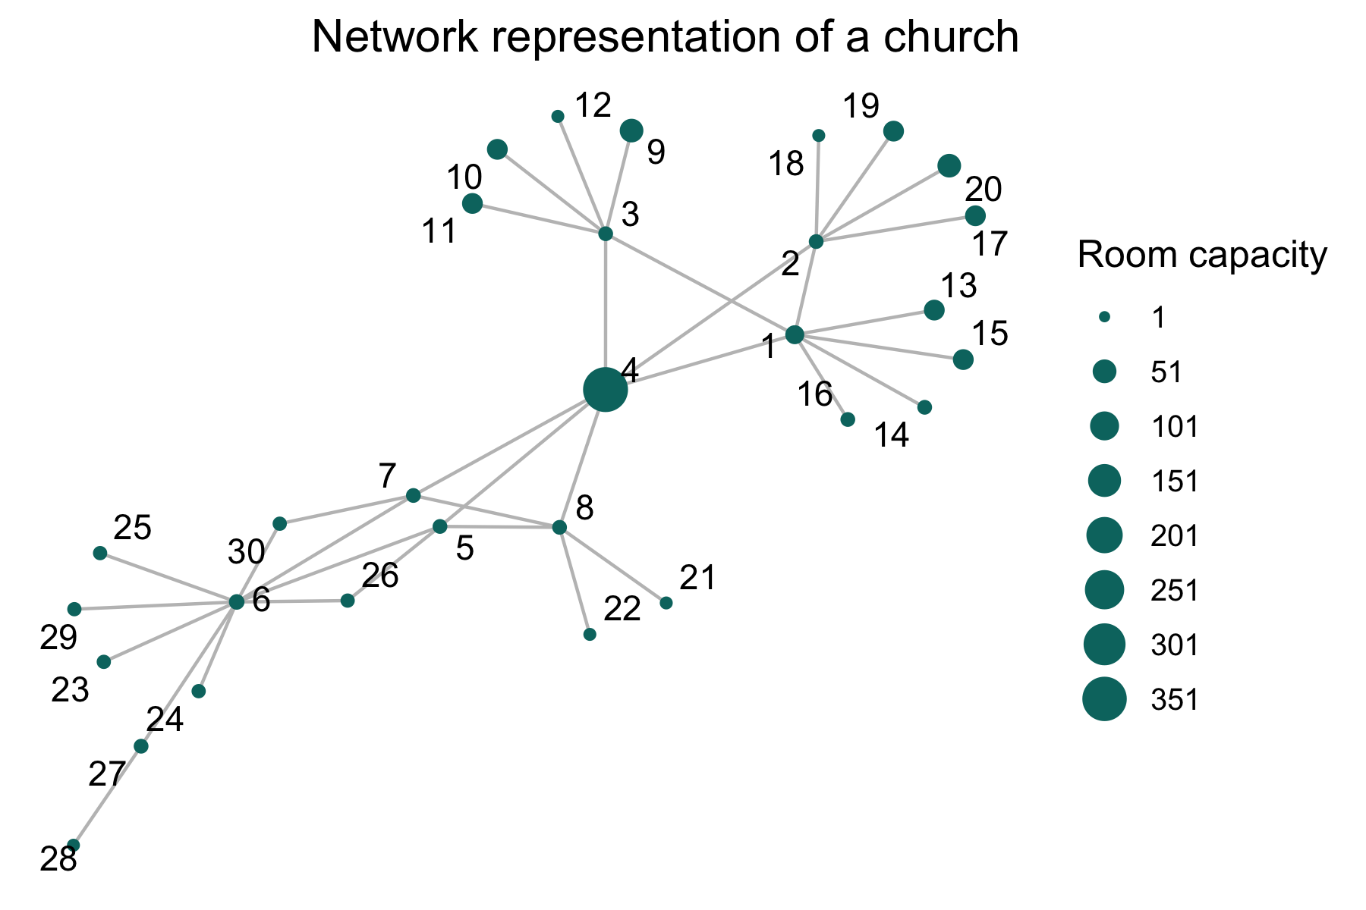
What the buildings and networks look like

Slide 5
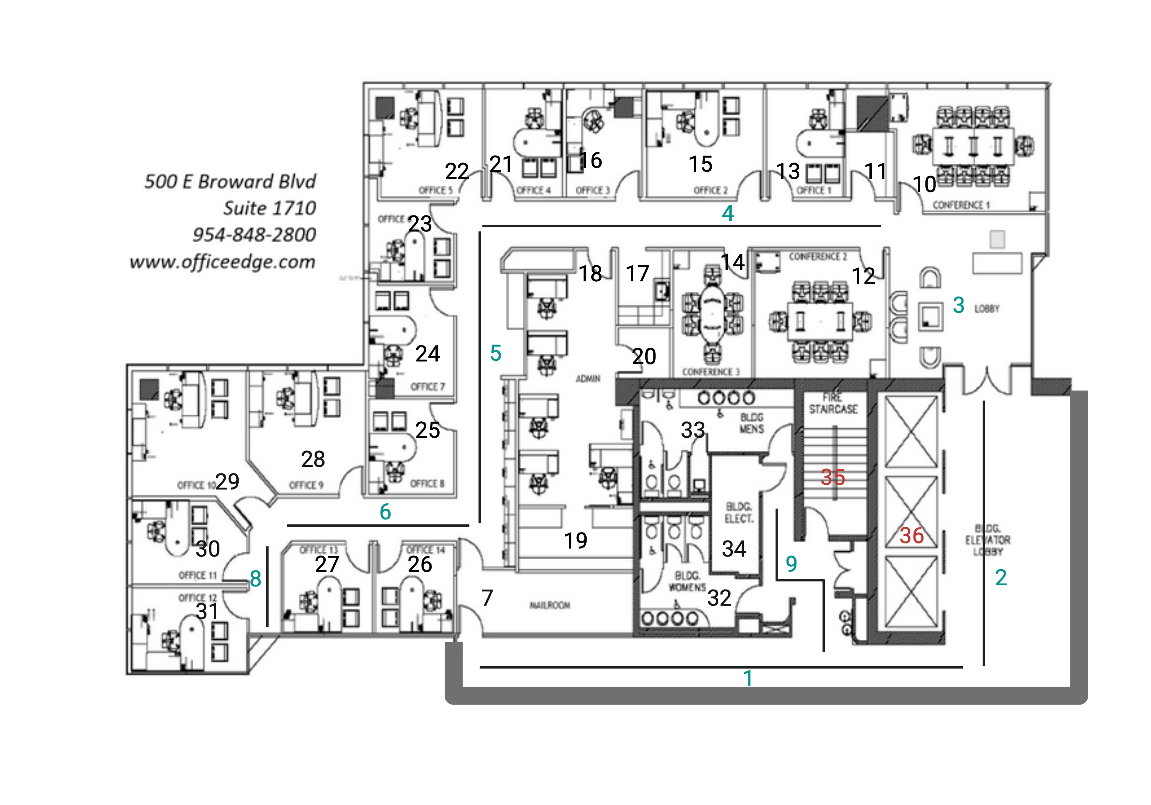
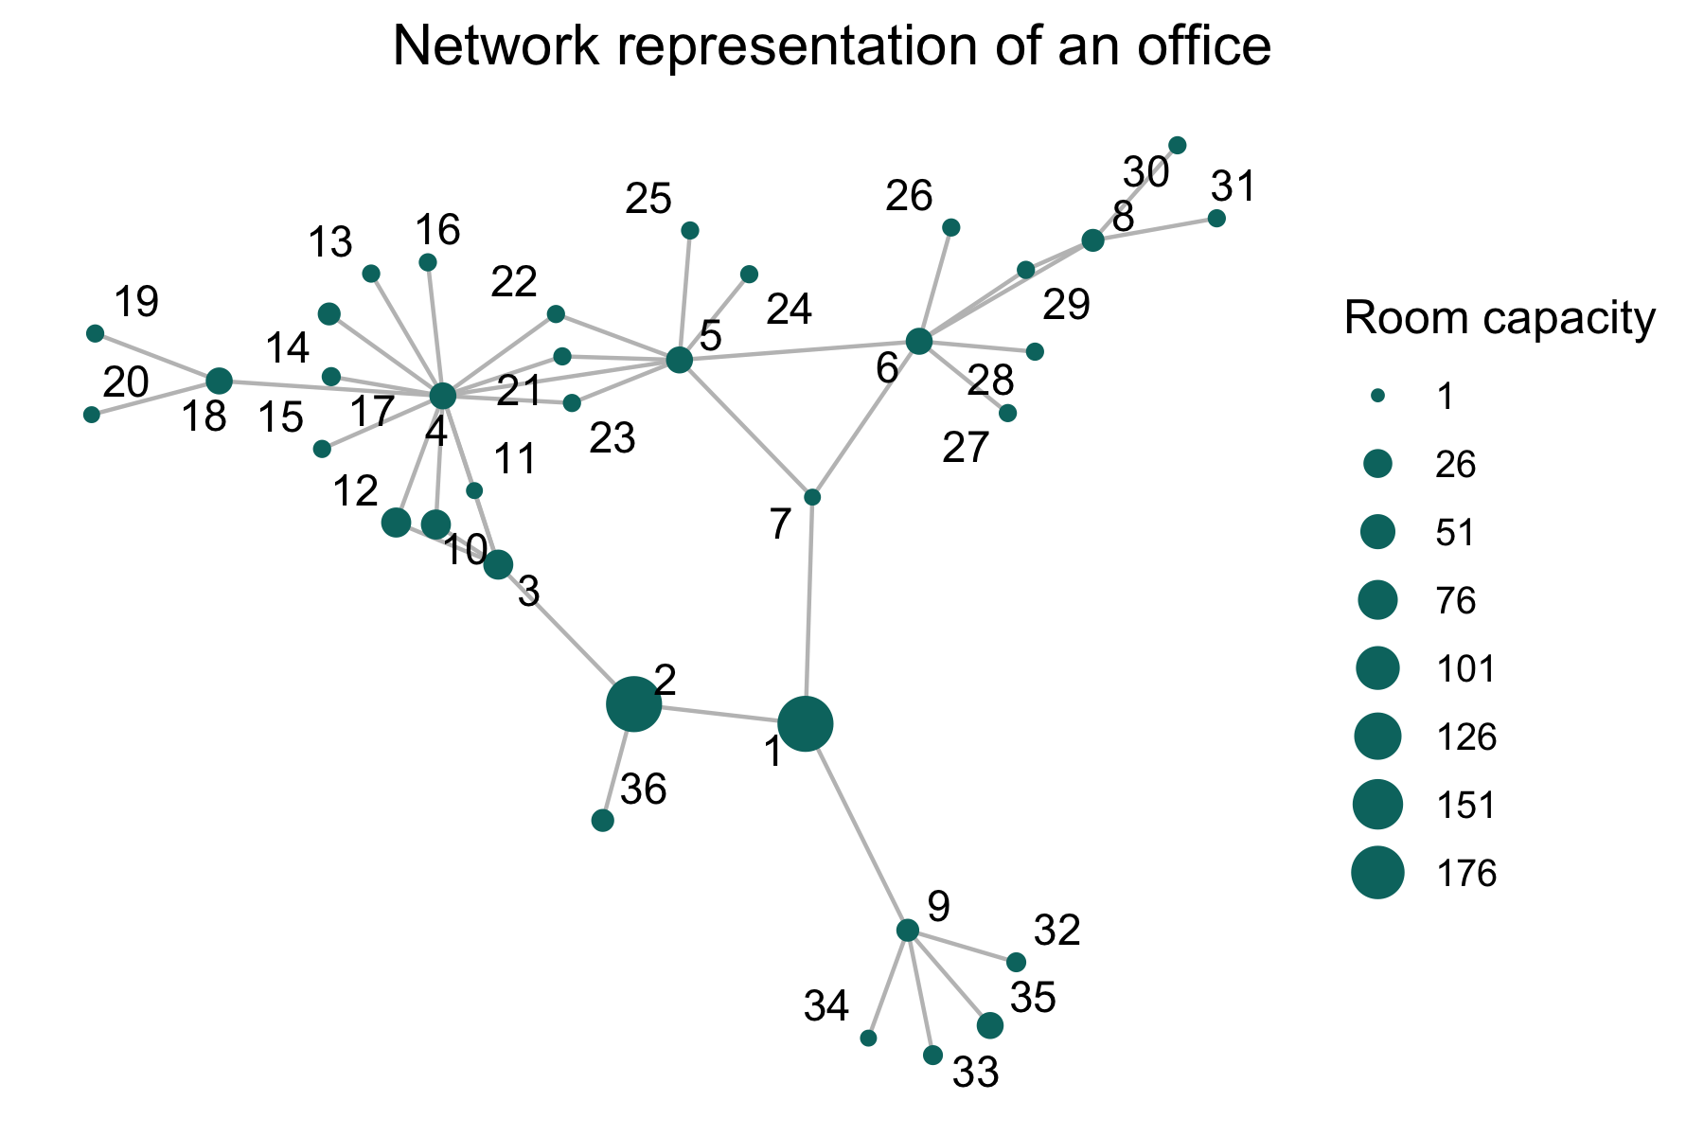
Office Building

Slide 6
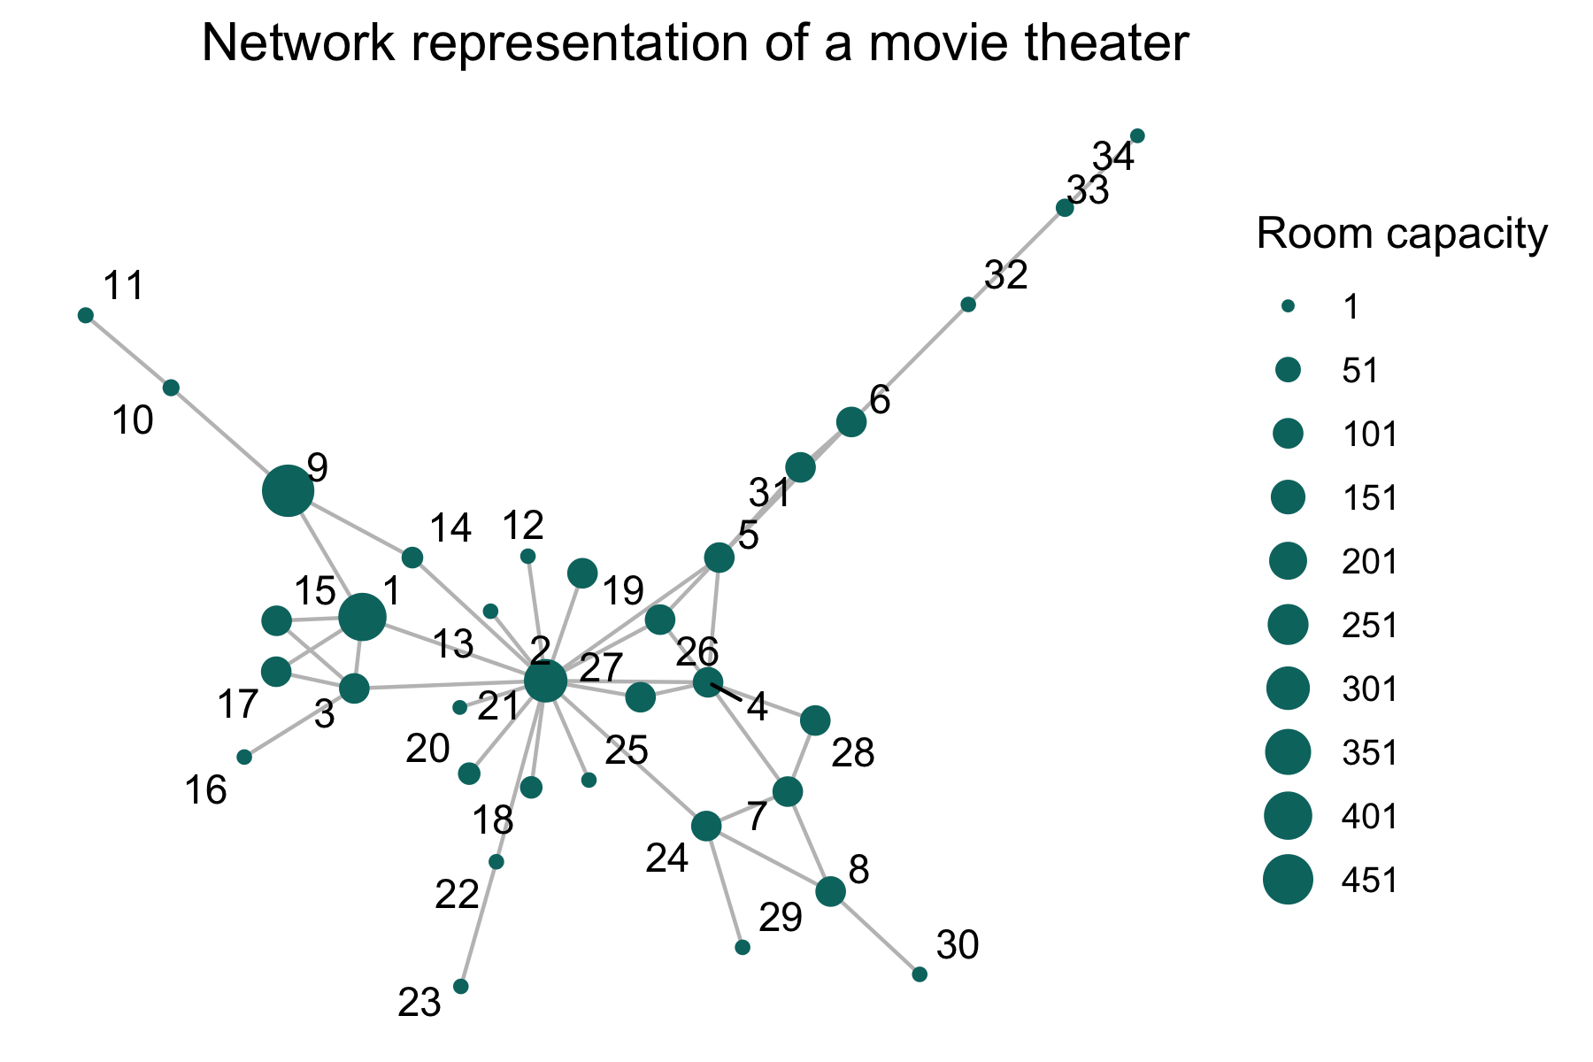
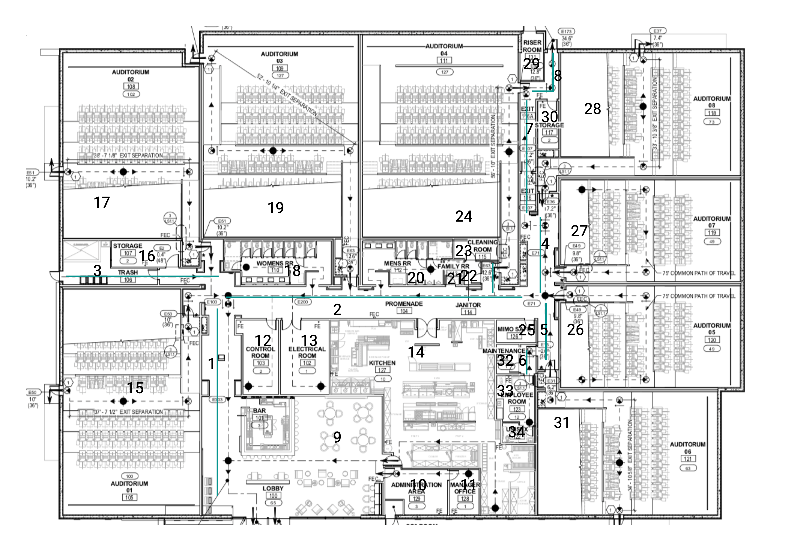
Movie Theater

Slide 7
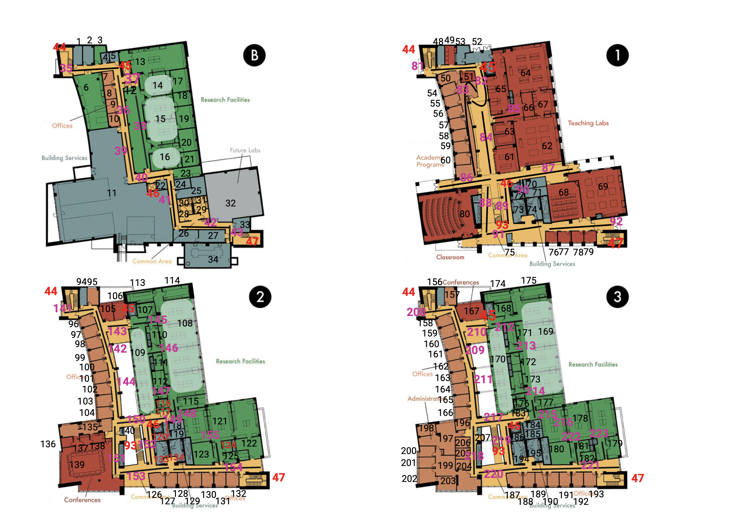
University building

Slide 8
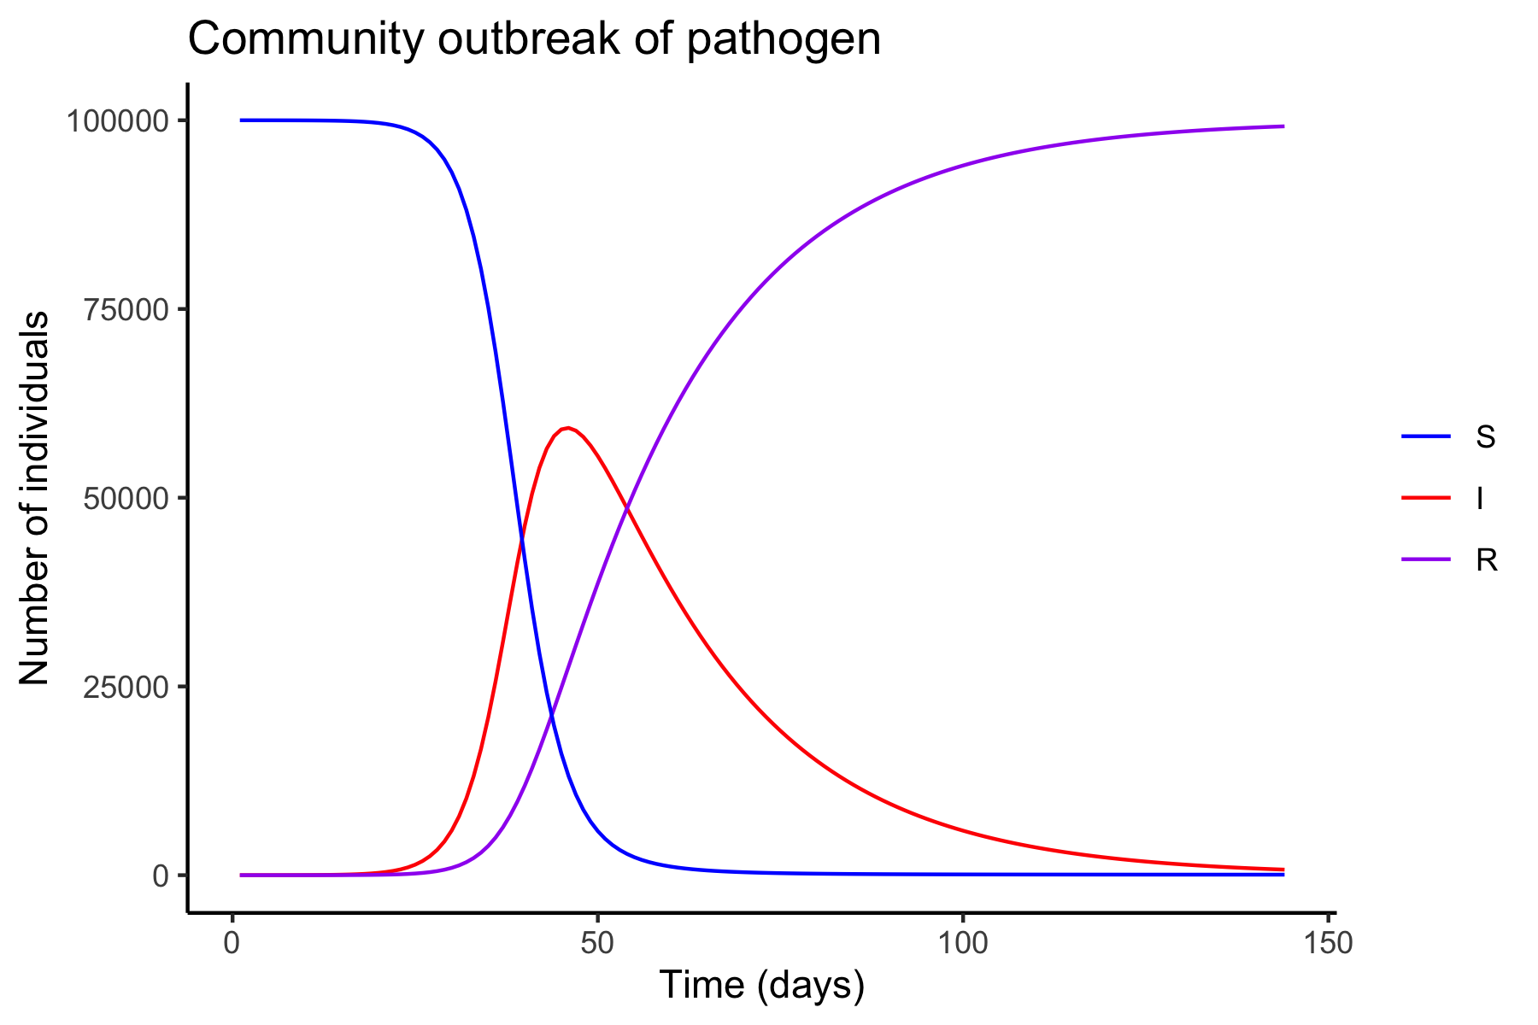
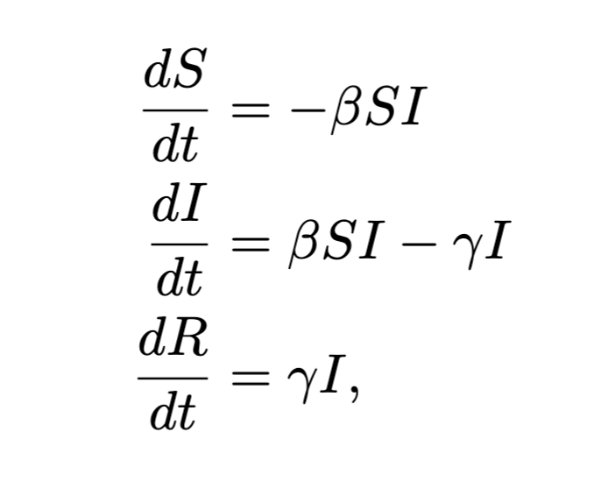
Community level model
Standard SIR model

Slide 9
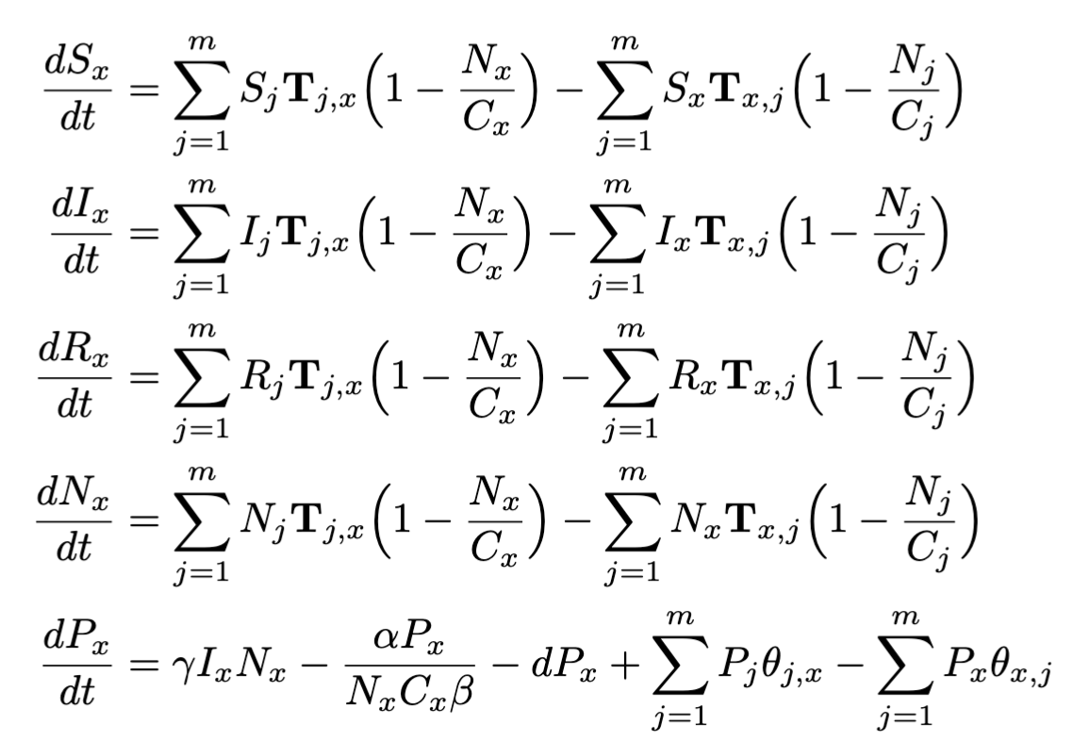
Building level model
S_x = Proportion of individuals in building that are Susceptible in room x
I_x = Proportion of individuals in building that are Infectious in room x
R_x = Proportion of individuals in building that are Recovered in room x
N_x = Number of individuals in building that are in room x
P_x = Number of infectious particles in room x

Slide 10
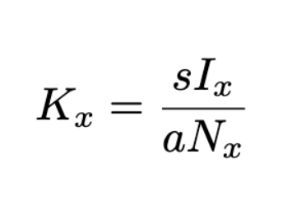
Evaluating risk
What we want to know is when a room is a high-risk room to be in
We define a room to be high risk when:
the number of infectious particles in the room is greater than the threshold level of risk.
The threshold level of risk is when the number of particles be shed into a room is greater than the number of particles being absorbed by people in the room.
We define this to be the threshold because when this is true, we know that infectious particles will be accumulating due to them being input into the room more than they are being removed via absorption.
Notes:
With this threshold, we can compare the number of particles in a room through time as estimated by the system of ODEs and compare that to the defined threshold K_x
When the number of infectious particles are greater than $K_x$ (i.e. $\frac{P_x(t)}{K_x} >1)$, room x is said to be at high risk.

Slide 11
Now let’s look at some code

